Slide 1
Returning to work

Slide 2
Types of Trauma related to grief and suicide
Sensory | Informational
Sensory Traces | Information and memory
Immediate arousal | Retrospective arousal
Personal and isolating | Social and Connecting
Avoidance and Numbing | Interpersonal Tensions
Hot cognitions | Uncertainties
Social De-bonding | Social De-bonding
Re-experienced aroused memories | Retrospectively interpret non aroused memories
Fear and Horror | Guilt and remorse

Slide 3
Trauma and Grief
Trauma | Grief
Intense threat | Loss of something good
Bad experience persists | Want to recapture it
Cant get away from it | Thinking of what is lost
Contaminates the present | Don’t want to forget
Fear and horror | Sadness and regret
High arousal | Exhaustion/fatigue
Distress and numbness | Distress and numbness
Want to avoid memories | Want to dwell on memories
Cant process information | Hungry for information
Loss of self awareness | Increased self awareness
Notes:
In trauma there is an injury to the psychological system. Cant function or functioning becomes impaired. Basic things become difficult or exhausting. Take extra time on tasks that were previously mindless. WE maintain arousal (Hyperviginlance/not feeling safe) sticking to the tragedy and can become isolated from rest of life.
Grief on the other hand can mean the reorganising of life around the absence of a loved one. It is often letting go, reducing arousal so change can occur. Change cannot occur with constant arousal so oftentimes we need to start with regulation. Concern also sits with life of person deceased and loss of future connection. Therefore grief can only be addressed when trauma has been managed.
Therefore trauma reactions have to be managed first.

Slide 4
Returning to work
Strategies
Inform workplace – you can request a family member, friend or service to provide information to workplace. This information should be approved by you. So what you feel comfortable with them knowing.
Perhaps allow one key person at your workplace to have enough information to keep speculation at a minimum. Keep him or her informed about funeral arrangements, time away from work, and how you are doing. You can delegate this – when you are heavily impacted by a traumatic loss do allow people to offer practical support.
The time required before someone returns to work can vary. Ensure you find out what options are available to you, for instance, sick leave, compassionate leave, annual leave. You could access an Employee Assistance Program (if your workplace has one). Super funds are also accessible in multiple cases as many hold insurance accessible for those severely impacted.
In general, it is recommended that you be honest and factual without being explicit as gossip and speculation about the deceased person can be hurtful and damaging to you.
Let your office know if you want to be included in regular correspondence so you can be kept updated about what is happening.
Good communication with your Manager or Supervisor will ensure that they continue to understand how grief is impacting on you and on your work.
Notes:
Understand that when informing a workplace that this has taken place ask person providing information to ensure that they talk to the fact that this kind of loss is not normal bereavement, but a traumatic loss. Traumatic losses can create issues in how we grieve and what that can look like. The response to how a death is dealt with when it’s a traumatic loss is not always the same in how its managed (Eg: coronial and police investigations, stigma, guilt/shame issues etc)
It is ok for some of this information to be provided to a workspace with resources on how people can be supported. These resources are freely available on Standby Website.
By directing information what we can do is ensure that individuals are being provided information as most people are at sea when it comes to managing this type of information. They often don’t know what to say or what to do. Its ok if you have support from a service to ask if they can provide information about what to expect. To also provide strategies and support information about how they can support someone moving back into a workspace.

Slide 5
Strategies
You may worry about emotionally breaking down in front of colleagues or in the middle of an important meeting. This can happen, but many people will understand if they know what has occurred in your life. If you need to excuse yourself, do so.
You might arrange to go into the office to meet co-workers for lunch. It can make it easier to go back to work at a later date.
Consider returning for partial days for a week or so, easing your way back into the normal routine.
You may return to work only to find that it was too early – you may need more time off.
Let people know what you are OK to talk about eg. your grief but not the death.
Your Manager may be able to consider various options for easing you back into work.
Let your co-workers know what is helpful to you when you are having a particularly hard day: allowing you to have some alone time, making you a cup of coffee, or going for a short walk. The more they know what they can do for you, the more comfortable you and they will be.
Good communication with your Manager or Supervisor will ensure that they continue to understand how grief is impacting on you and on your work.
If you have young children or teens impacted – expect disruption and distress/separation anxiety (Additional information about supporting young people can be provided)
DELEGATE

Slide 6
How we can intervene
Objectives of intervening | examples
Finding meaning | Honouring the loss Changing attitudes to suffering Reframing with metaphor Creating healing narratives Use of spiritual cultural approaches Supporting meaning making
Renegotiating with relationship of what was lost | Others ways to conceive the connection Memory activities Honouring the memory of person who is deceased Therapeutic approaches/ CBT/ACT etc
Using social support | Connection making Educating supporting family/friends Lived experience connection Therapy Spiritual/cultural support
Re-establishing life post loss | Strength based process Step approach/collaborative and choice based

Slide 7
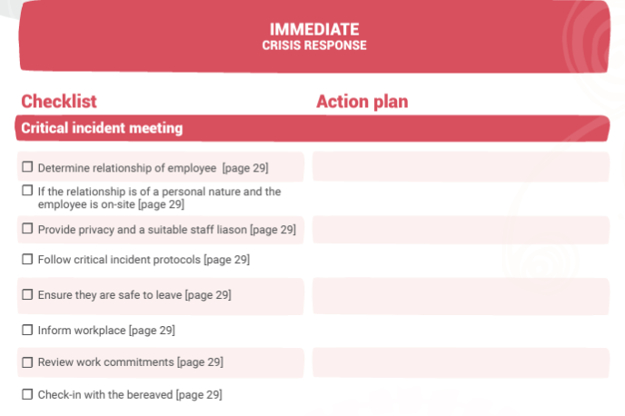

Slide 8
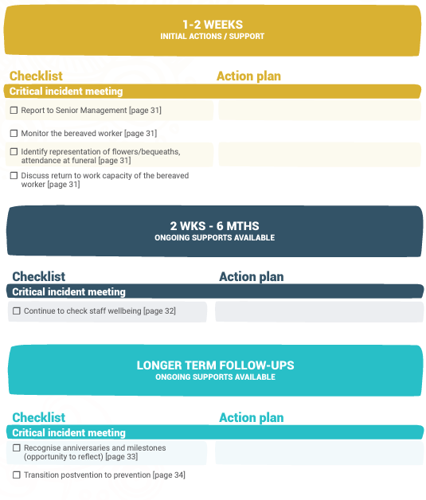
Workplace response checklist

Slide 9
Services and Resources
Kids Helpline 1800 55 1800
www.kidshelp.com.au/teens/get-help/web-counselling/
Headspace Centres
www.headspace.com.au
Reach Out www.reachout.com.au
(this is not a crisis service / does not provide one-on-one counselling)
Suicide Call Back Service 1300 659 467
(people aged 15 years and over)
Australian Centre for Grief and Bereavement www.grief.org.au/
Sabrina’s Reach4Life/Bereavement Group (BBSGNT) - Mobile: 0491 311 211
info@sabrinasreach4ife.com.au
https://sabrinasreach4life.com.au/
StandBy Support after Suicide - Local Standby Site/NT – 0418575680
https://standbysupport.com.au/resources/?gclid=CjwKCAjw0a-SBhBkEiwApljU0rb9x0yLMmQkg3lwT_RVnIok1J-GZ5pumdOOesJ2iIRxZunQbRG2rxoC-3QQAvD_BwE#freebooks
Notes:
Give participants a list of resources and services. Bring brochures to hand out / have on display for participants

