Slide 1
Trauma and Loss

Slide 2
Trauma - Definitions
Trauma is the emotional, psychological and physiological residue left over from heightened stress that accompanies experiences of threat, violence and life-changing events.
Childhood association
Notes:
Trauma is a word used to cover many situations including natural disasters, accidents, war, forced migration and even overwhelming family problems.
It is anything that shatters your beliefs about yourself and your world.
Trauma occurs when something happens that goes beyond your capacity to defend yourself, your family or others.
Our Definition is based on FASSTT network because of who we work with, but as you can see by childhood association definition, trauma is not restricted to a single group.
We use our particular definition because often our (Melaleuca) client group has experienced trauma as a result of their journeys from country of origin. We don’t say country of citizenship as for many that we work with have possibly been born in a camp, or alternatively are considered stateless and have no citizenship.
(75% of refugees (adult and children) have been exposed to traumatic events. Refugees are often exposed to multiple traumas. It is rarely the case that they encounter only a single traumatic incidence.) May hold this with a more generic audience.
2

Slide 3
Contexts of trauma
Community Violence
Complex
Domestic Violence
Early childhood
Medical
Natural disaster
Neglect
Complex
Domestic Violence
Early childhood
Medical
Natural disaster
Neglect
Community violence

Slide 4
TRAUMA
4 core assumptions fundamental to our belief in such invulnerability:
(1) The world is benevolent or at least benign;
(2) Life is meaningful;
(3) We have control over our lives; and
(4) Positive self-worth.
Notes:
How is it that trauma through exposure to these acts (even) exists?
Because we all share 4 core assumptions that are fundamental to our belief system.
SLIDE – reveal of four beliefs
The experience of trauma makes one acutely aware that these assumptions are not true and thus one's ability to act as if these basic assumptions about the world are valid; is lost.
One can no longer believe that people are basically good and that good things happen to good people or that by engaging in the "right" behaviours, one can create positive outcomes and avoid negative outcomes. Trauma impairs beliefs about the meaningfulness of life because one cannot make sense of an unpredictable, uncontrollable, and unjust world. Lack of control yields a sense of vulnerability because this person-outcome contingency is broken.
The traumatized state reinforces this belief as one's physical and psychological stability has been eroded - one has literally lost control of one's normal modus operandi. A worthy self is deserving of positive outcomes, but trauma proves this too can be an unrealistic expectation.
In trauma, fairness, justice, security and stability seem to be arbitrarily and universally removed. Thus, the defence mechanisms which enable one to maintain psychological stability break down, and as Freud (1949) so accurately pointed out, these mechanisms are critical to keeping intolerable levels of anxiety at bay. Without the so-called sweet lies about life - the distortion of reality that these defence mechanisms provide- we cannot maintain psychological equilibrium.
Issues of trust created by trauma in the context of an intimate relationship may become generalized to future relationships, creating problems in developing one's social support network. Terror of getting re-victimized in a new relationship is very common, which although unpleasant, helps prevent its occurrence due to the conscious awareness of it. Some forego new relationships, having great difficulty in initiating and/or maintaining them. However, given the lack of a tendency toward emotional numbing (which makes maintaining intimate relationships difficult), withdrawal from, or significant disruption of all social relationships is much less likely in PTRS than in PTSD. Others may struggle with trust issues and relationship difficulties only in the type of relationship in which the experience of trauma occurred. For example, trust issues in romantic relationships are particularly common for those who experienced trauma in this type of relationship. Similarly, sexual dysfunctions (e.g., loss of interest in sex, risky sexual practices, and infidelity issues) are strongly associated with a history of sexual abuse in an intimate relationship. Not only does attachment trauma bring up issues regarding trust of others, but it also raises issues of trust of one's self by calling into question one's judgement of character. How one's view of others could be so erroneous becomes a puzzle, and if one's assessment of character was so wrong in the case of the perpetrator, how does one know that the assessment of the character of others in one's social world is accurate? Such self-doubt regarding one's perceptions of one's social world is another avenue via which impairment in one's social support network can occur for victims of PTRS.
Traumatic Stressors challenge one's knowledge of the self and/or world. Maimed or shattered beliefs create a state of psychological crisis until new paradigms can be adopted, for these are the basis of our psychological stability. Trauma can destroy our functional illusions of individual invulnerability.
4

Slide 5
Trauma Reactions
4 areas of concern
Anxiety
Grief / Depression
Loss of meaning and purpose
Guilt and shame
intrusive reactions:
avoidant reactions:
hyper-arousal reactions:
Notes:
While the symptoms of trauma need to be recognised as culturally diverse and specific (Wasco, 2003), trauma reactions are generally divided into three categories:
Intrusive Reaction:
dreams/nightmares, flashbacks, obsessive thoughts, physiological reactions and other persistent re-experiencing of the traumatic event;
Avoidant reaction:
general numbing in responsiveness and avoidance (particularly of things related to the traumatic material); and
Hyper-arousal:
hyper-vigilance and difficulty concentrating.
The core experiences of psychological trauma are:
Disempowerment and disconnection from others
Recovery, therefore, is based upon the empowerment of the survivor and the creation of new connections. Recovery can take place only within the context of relationships; it cannot occur in isolation.
Herman, Judith, Trauma and Recovery, 1992

Slide 6
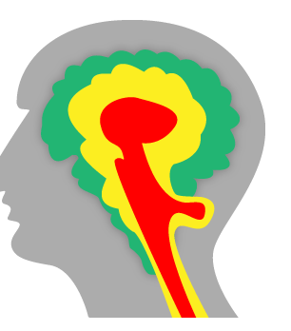
The Brain/body
Survival Brain - Reptilian
Emotional Brain – Limbic
Thinking Brain - Neo-cortex
Notes:
Exploring the biological impact of trauma.
Discussion starts with consideration of the brain – the organ that essential drives us as individuals, as humans.
Simple review of the brain – how it operates when developed.
Three ‘layers of operation’
Note to Joan – sugesting this slide requires a simple explanation of how these three layers operate and what they control
THEN move to an explanation of the impact of trauma and what happens. - this is on the next slide.
ESSENTIAL to break this into 2 parts. This needs to be enough to understand without being distracting.
WHAT Happens in the event of trauma experience:
Traumatic events can change the structure of the brain:
Hippocampus – SHRINKS
→ Memory, concentration problems
Amygdala – ENLARGES
→ Increased anxiety, stress, fear, aggression
NOTE: hippocampus is NOT explicitly shown on this diagram???...but assuming is it within one of these three ‘layers’….
The hippocampus is a major component of the brains of humans and other mammals. It belongs to the limbic system and plays important roles in long-term memory and spatial navigation. Like the cerebral cortex, with which it is closely associated, it is a paired structure, with mirror-image halves in the left and right sides of the brain. In humans and other primates, the hippocampus is located inside the medial temporal lobe, beneath the cortical surface.
Role in memory
Psychologists and neuroscientists generally agree that the hippocampus has an important role in the formation of new memories about experienced events (episodic or autobiographical memory). Some researchers view the hippocampus as part of a larger medial temporal lobe memory system responsible for general declarative memory (memories that can be explicitly verbalized—these would include, for example, memory for facts in addition to episodic memory).
The amygdalae, 'almond', 'tonsil', are almond-shaped groups of nuclei located deep within the medial temporal lobes of the brain in complex vertebrates, including humans. Shown in research to perform a primary role in the processing and memory of emotional reactions, the amygdalae are considered part of the limbic system.
Emotional learning
In complex vertebrates, including humans, the amygdalae perform primary roles in the formation and storage of memories associated with emotional events. Research indicates that, during fear conditioning, sensory stimuli reach the basolateral complexes of the amygdalae, particularly the lateral nuclei, where they form associations with memories of the stimuli. The association between stimuli and the aversive events they predict may be mediated by long-term potentiation, a lingering potential for affected synapses to react more readily.
Memories of emotional experiences imprinted in reactions of synapses in the lateral nuclei elicit fear behavior through connections with the central nucleus of the amygdalae. The central nuclei are involved in the genesis of many fear responses, including freezing (immobility), tachycardia (rapid heartbeat), increased respiration, and stress-hormone release. Damage to the amygdalae impairs both the acquisition and expression of Pavlovian fear conditioning, a form of classical conditioning of emotional responses.
Memory modulation
The amygdalae also are involved in the modulation of memory consolidation. Following any learning event, the long-term memory for the event is not instantaneously formed. Rather, information regarding the event is slowly assimilated into long-term storage over time (the duration of long-term memory storage can be life-long), a process referred to as memory consolidation, until it reaches a relatively permanent state.

Slide 7
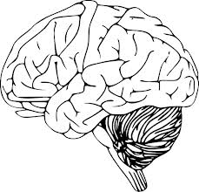
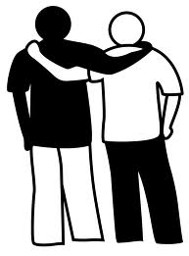
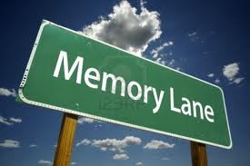
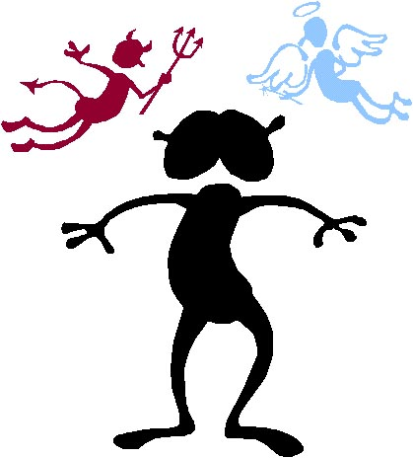
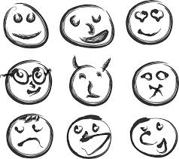
Impact on Individual/Bio-Psychosocial Model
Relationships
Body
Brain
Memory
Trauma
Learning
Behavior
Emotions
Notes:
An overview of how an individual might be impacted by trauma.
Brain development and function
The body - physically and mentally
Learning and/or memory difficulties
Interactions with others (relationships and your behaviour)
Emotions – at the time and in reflection – controlled or not.
We will explore these in more detail as we progress through the workshop.
NOTE: - this slide is an overview – try to avoid exploring any of these in too much detail at this point. Avoiding repetition. The slide is really for ‘sign posting’ the breadth of discussion ahead.
7

Slide 8
Grief and Loss
Loss
The difference between what was there and what is missing (Miller and Omarzu, 1998)
Grief
The emotional response to loss – the complex amalgam of painful affects including sadness, anger, helplessness, guilt and despair (Raphael, 1984)
Bereavement
The loss through death of a significant other (Freud)
Mourning
The psychological mourning processes that occur in bereavement or simply the feelings inside that occur after loss (Raphael, 1984)
The social rituals or acts that we do on the outside that are part of our grief and and shaped by our culture or societal practices (Stroebe, Hansson & Schut, 2001)
Notes:
Derives from the Latin gravis ‘to bear’ and from which comes the word ‘gravity’ (Hollis, 1996:45)
Ask the participants to break into groups and discuss for a couple of minutes how they mourn and what has influenced this.

Slide 9
Trauma and Grief
Trauma | Grief
Intense threat | Loss of something good
Bad experience persists | Want to recapture it
Cant get away from it | Thinking of what is lost
Contaminates the present | Don’t want to forget
Fear and horror | Sadness and regret
High arousal | Exhaustion/fatigue
Distress and numbness | Distress and numbness
Want to avoid memories | Want to dwell on memories
Cant process information | Hungry for information
Loss of self awareness | Increased self awareness
Notes:
In trauma there is an injury to the psychological system. Cant function or functioning becomes impaired. Basic things become difficult or exhausting. Take extra time on tasks that were previously mindless. WE maintain arousal (Hyperviginlance/not feeling safe) sticking to the tragedy and can become isolated from rest of life.
Grief on the other hand can mean the reorganising of life around the absence of a loved one. It is often letting go, reducing arousal so change can occur. Change cannot occur with constant arousal so oftentimes we need to start with regulation. Concern also sits with life of person deceased and loss of future connection. Therefore grief can only be addressed when trauma has been managed.
Therefore trauma reactions have to be managed first.

Slide 10
Types of Trauma related to grief and suicide
Sensory | Informational
Sensory Traces | Information and memory
Immediate arousal | Retrospective arousal
Personal and isolating | Social and Connecting
Avoidance and Numbing | Interpersonal Tensions
Hot cognitions | Uncertainties
Social De-bonding | Social De-bonding
Re-experienced aroused memories | Retrospectively interpret non aroused memories
Fear and Horror | Guilt and remorse

Slide 11
Traumatic Loneliness
Safety in solitude
Distorted perceptions, expectations, predictions, emotions about self and others
Need for invisibility
Lack of healthy boundaries – too rigid or too lax
Hostility to others
Relationships frighten rather than comfort
Notes:
Other element of complex trauma is traumatic loneliness.
Traumatic Loneliness – might be seen in those who have been exposed long term to trauma and / or without positive attachment
This is characterized by survivors learning that they are safer when alone.
The sense of relief and security experienced can become conditioned in the presence of stressful experiences. And rather than reach out for help survivors are likely to withdraw and become invisible.
Traumatic Loneliness is a potential output of the trauma experience and this has denied them forming healthy or good attachment in any important relationship.

Slide 12
Recovery
EXPECTATIONS
REALITY
Notes:
Q: What do we hear from people when we go through something stressful or Traumatic?
Q: What might you get from an uninformed person – generic advice?
Wait for audience feedback.
Sorts of things people might say
Get over it!
Why are you holding onto this?
What’s wrong with you?
It’s time to move on
Let it go
It’s in the past.
But the reality is more this … its not easy
SLIDE reveal
The reality is that until we retrain our brains and nervous systems to respond to situations in a new way after they have adapted to living in a state of danger and toxic stress we will be placed in a space of reacting to what our body is telling us is dangerous even if its not.
Because this is a situation where no history is the same, no recovery can be the same.
What makes us feel like we are in danger…. Our sense of safety… the triggers activating that sense of safety and having us enact those adaptions that have kept us alive or going in whatever space we have survived – these will be different for everyone.

Slide 13
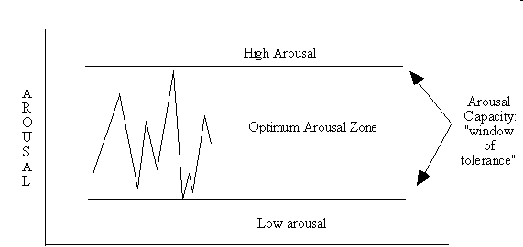
Window of Tolerance
Source: Pat Ogden (2000)
Notes:
Exploring stress in the context of how a body responds in a biological / physiological sense.
Our body has internal mechanisms that are designed for protection – as seen with the nervous system.
Introducing what is known as Window of Tolerance - the space between high arousal and low arousal that allows us to tolerate certain circumstances or situations without an abnormally adverse reaction.
Note: this is to introduce the window of tolerance only at this point…it is explored in a bit more detail in later slides.
Normal means FUNCTIONAL, as meant by nature
Stress and purpose of stress.
Functional stress
When stress turns into fear, the functional purpose of fear is fight or flight!
When purpose is achieved the Parasympathetic and sympathetic are to work in harmony and balance
When the event is too frequent and there is no time for the parasympathetic and when there is the freeze reaction
With toxic stress - prolonged exposure to stress hormones - can lead to impaired brain development and functioning - already explored and discussed.
13

Slide 14
Grounding
Grounding is about learning to stay present -or for some get present in the first place - in your body in the here and now.
Activities build
Sensory awareness
Cognitive awareness

Slide 15
Supporting Recovery – what works in Trauma?
Safety – An individual needs this first
Choice/Collaboration/Control
Trusting relationships
Awareness/Understanding
Capacity and Skills to assist
Gradual steps
Responsive & respectful
Client centred
Psycho-education/Literacy of self
Notes:
This is a very helicopter view of principles underpinning recovery support
Have explored and developed an awareness and understanding of the trauma impact and effects on biological, psychological and social levels.
There are a number of things we add to our toolbox as well in terms of dealing individually with people though and they may include a number of items.
Firstly I think one of the most effective tools in our toolbox is psycho-education. (NEXT SLIDE)
Its very empowering to people to know this is actually a normal function of our body that’s had to adapt to abnormal events. keep in mind the following guidelines though when working with other cultures.
Use different metaphors – not ethno centric
Foster cultural specific methods
Do NOT Pathologise
Focus on adjustment in the new country
Understanding distress in context.
Sometimes recongnise that psycho ed can include the whole family group.
We have to be able to think broadly and advocate with those we work with and not necessarily the way we might think either….. This advocacy can be in some ways simply through linking a client using warm referrals (they have trust and relationship issues remember) to other people that can assist with what they need. The more relationships that are healthy and positive for someone the better in recovery. The other aspect around something simple in referring someone by advocating for them to another service is that if they are at risk of becoming homeless, for someone who has been dispossessed or fled from their homeland that’s a trigger and the referral is a way of working towards dealing with alleviating that trigger. In terms of advocacy education and access to education is also quite significant…. The capacity of for a person to master information/knowledge is very powerful.
We also need to realise that because relationships heal as we all know to start to working with people to connect them as much as possible to a diverse array of support systems its why community development activities such as music dance gardening, cooking and other sensory based activities are so good. As they work with both the attachments and connections but also the sensory calming of a familiar and pleasant activity. So works with brain and also nervous systems…..
Its also important to think if we are working as non clinicians to apply the idea of universal precautions… so basically applying the idea that everyone we meet has potential for traumatic background and therefore we apply the principles of trauma informed practice to all.
There are other issues such as language, a core component of feeling safe is the capacity to adequately articulate our need to another who can help us meet the need. What happens when that is not available, or the service providers are unwilling to provide means, or they the service providers simply fail to address issue of dialect, or correct language and not asking someone their preference.
In terms of some of the other things to think about:
Think in terms of:
Containment
Calibration
Genuine responding within boundaries
Avoiding premature reassurance
Attitude of openness and curiosity
“Not knowing”
Start where they are
Allow a space to talk about the losses, their country, their culture
Their strengths – Strength based work is a common approach in Refugee Trauma work…. its been very useful in supporting someone's sense of control and power over situations.
Also engage with the present and future
Really listening is a skill and can be a powerful intervention in itself
Mindfulness, meditation, Integrating spiritual practices, exercise… health…. promoting good nutrition is absolute…….. SEEDS – Social support Exercise Education Diet Sleep
For those though that are working with traumatic memories it really must be when the individual is operating within the window of tolerance… where safety has been established.
Common therapies for trauma work is things like CBT/EMDR/NET (narrative exposure therapy) which was developed specifically for working with refugees. body based therapies which integrate talk therapy with techniques that bring the body into counselling as a therapeutic resource increase awareness of body sensations, behaviors, emotions, and thoughts so the client can learn the relationships between them…. These are some of those items.
Relaxation
Body scanning
Mindfulness
Focus on breathing
Tracking the pain
Drawing the body
Drawing the pain
Sandplay
Drumbeats
Theres also yoga, accupuncture, massage, aromatherapy, physio… which makes sense when you think that muscle tension is a bodies way of storing pain.
There is also items like tapping, self regulation and self soothing. Other Sleep hygiene techniques are really important given that sleep issues are common features of trauma particular refugee trauma. Working with nightmares, short term solution orientated counselling, grief work as grief is highly significant in these populations. Other considerations around culture and being forced to leave so violently is the severe grief experienced by people complicated by trauma. Some cultures have complicated rituals around death that are never completed and so traumatic grief issues are common…. But also too the grief of loss of home, family, normal life etc also mean issues around grief.
There is a lot of grief to deal with and culturally speaking just in terms of lost loved ones, grieving rituals that were never able to be completed makes for recovery from grief very difficult for people.
Our sister agency in Sydney STARRTTS also integrates things like biofeedback, neurofeedback and HRV (Heart rate variability)into therapeutic work as well… so there is a plethora.
These lists are not exhaustive.

Slide 16
How we can intervene with traumatic grief
Objectives of intervening | examples
Finding meaning | Honouring the loss Changing attitudes to suffering Reframing with metaphor Creating healing narratives Use of spiritual cultural approaches Supporting meaning making
Renegotiating with relationship of what was lost | Others ways to conceive the connection Memory activities Honouring the memory of person who is deceased Therapeutic approaches/ CBT/ACT etc
Using social support | Connection making Educating supporting family/friends Lived experience connection Therapy Spiritual/cultural support
Re-establishing life post loss | Strength based process Step approach/collaborative and choice based

Slide 17
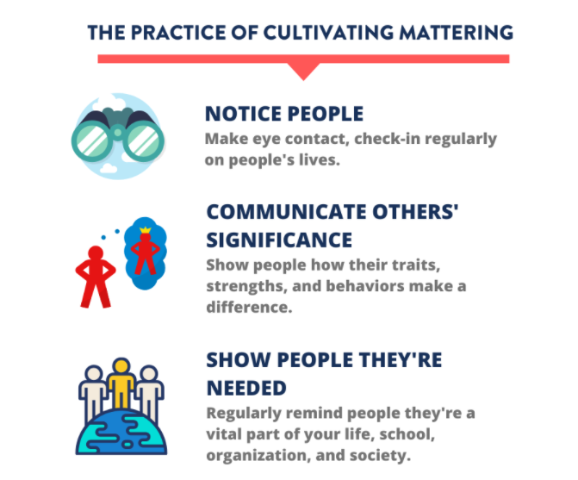
CAPPO
C – Calm
A – Attuned
P – Present
P – Predictable
O – Others don't escalate me
Notes:
we understand that mattering can be broken down into two essential moments “Recognition and impact. The moment of recognition refers to signals we receive from the world that our presence matters, that we have to say has meaning and that we are acknowledged in the room, in our family, at work and in the community at large. The moment of impact in refers to our sense of agency; that what we do makes a difference in the world and that other people depend on us. Each of these moments exist on a continuum. The moment recognition has at one end a sense of entitlement and at the other end the feeling of invisibility. Neither extreme is good for health personal or collective well-being.
WE all need to feel recognised acknowledge and appreciated in good measure without demanding too much attention or privilege at the expense of others. At the same time we must avoid invisibility which plagues minorities and oppressed communities, feeling ignore, neglected and forgotten is a violation and so we must struggle to find the bit in the middle.
Reference: Isaac Prilleltensky meaning making, mattering and thriving in community psychology: from co-potation to amelioration and transformation.

Slide 18
Personal Self Care
Daily exercise
Balanced diet
Sufficient sleep
Build competence : skills & confidence
Social interaction
Spiritual practice
Practice gratitude
Maintain boundaries
Building our protective factors/resilience
Notes:
What can individuals do?
Start with primary prevention; things that might help everyone.
This will have a focus on resilience-enhancing behaviours. Evidence-based activities that can benefit everyone physically, mentally and spiritually and may help to resist burnout.
A second resilience-enhancing activity is engaging in daily physical exercise. You might first think of running or swimming, strenuous exercise, which is great but not always feasible. Walking, going up and down the stairs, lifting weights, yoga and just moving about rather than sitting at our desks for hours on end also contribute to a healthier body, mind, and spirit.
Equally important is eating a healthy diet. Mom was right when she said, “eat your veggies.” It’s not always easy to eat right when you’re at work, but it does our bodies tremendous good to eat the rainbow (foods of different colors) every day, stock up on fruits, veggies, and complex carbohydrates (like beans and grains), rather than eating fast foods or lots of meat.
It may sound difficult, but getting enough sleep is hugely important. And we now know that this means something like 8 hours a night, plus a nap if you can...no kidding! I had a friend who kept an inflated air mattress in his closet at work so he could grab a nap for 20 minutes during his lunch hour every day. Research has established that people who nap are more productive at work in the afternoon than those who don’t—tell your boss!
Another very useful way to build resilience is to develop competence (the skills you need to do your job) and confidence (the knowledge that you can do it). We can build our skills through study and apprenticeship, for example. Sometimes we have the skills but don’t trust ourselves. Confidence comes about through practice and feedback.
One of the best-documented ways to enhance our resilience is to build and use social support. This means finding people in your personal and professional life whom you can talk to about what’s important to you (emotional support) and whom you can ask for help when you need it (instrumental support). We can do this through Skype, Facebook or other social media outlets, or good old phone, written, or in-person contact.
It’s very helpful to try to look at life through a positive lens rather than negative one. This doesn’t mean to deny that bad things are happening. Rather, it means searching for the good in our life circumstances, facing challenges with realistic optimism rather than with dread or gloom, and trying to find lessons in the inevitable setbacks we all encounter.
Finding meaning or purpose in your daily activities and your work can be very helpful to preventing burnout. Knowing how your job fits in to the larger picture of your agency’s mission is one example that can keep us connected to the value of our work.
We cannot overemphasize the value of engaging in a spiritual practice. For some people, this will mean prayer or other practices reflecting their faith. For others, meditation, spending time in nature, engaging in meaningful contributions to others can all be spiritually nourishing. A friend of mine spends time almost every day helping out her friends and neighbours, with a loving heart and generous hand. She is a spiritual rock star
Practicing Gratitude:
Can take the form of setting aside time – a few minutes each day – to reflect on a few things for which you are thankful or grateful. May write them down – and have target – three per day. May share them with a partner.
It is the practice that is important; taking the time to reflect on the positive contributions into your life. Including something that relates or impacts on your relationships may enhance the benefit.
My husband and I try to do this together every night over dinner: each of us names three things we’re grateful for that happened in the past 24 hours.
Note: leave the discussion of boundarie to the next slide. Use the handouts as the activity and then move to discussion of boundaries with the next slide.
Activity:
Review the list and select items that you are currently practicing
OR
Review the self reflection questions and have participants complete at least 3.
For either activity should allow no more than 5 minutes. If you invite the participants to share their responses, allow a further 3 minutes.

Slide 19
Services and Resources
Kids Helpline 1800 55 1800
www.kidshelp.com.au/teens/get-help/web-counselling/
Headspace Centres
www.headspace.com.au
Reach Out www.reachout.com.au
(this is not a crisis service / does not provide one-on-one counselling)
Suicide Call Back Service 1300 659 467
(people aged 15 years and over)
Australian Centre for Grief and Bereavement www.grief.org.au/
Sabrina’s Reach4Life/Bereavement Group (BBSGNT) - Mobile: 0491 311 211
info@sabrinasreach4ife.com.au
https://sabrinasreach4life.com.au/
StandBy Support after Suicide - Local Standby Site/NT – 0418575680
https://standbysupport.com.au/resources/?gclid=CjwKCAjw0a-SBhBkEiwApljU0rb9x0yLMmQkg3lwT_RVnIok1J-GZ5pumdOOesJ2iIRxZunQbRG2rxoC-3QQAvD_BwE#freebooks
Notes:
Give participants a list of resources and services. Bring brochures to hand out / have on display for participants

